Slide 1
IML-House Pricing
D21027-Priyanka G
D21031-Sakshi Bhoir

Slide 2
Attributes
The dataset contains categorical and numerical columns.
Under categorical (nominal, ordinal data)
Id,date,bedroom,bathroom,floors waterfront,view,grade
Under numerical
Price, sqft_living, sqft_lot, sqft_above, sqft_basement, sqft_living_above, sqft_lot_below.

Slide 3
Hypothesis
The house price increases with increase in square feet living and grade.
The house price increases with the view and waterfront.
The house price might even increase based on the year it was built.

Slide 4
EDA Conclusions

Slide 5
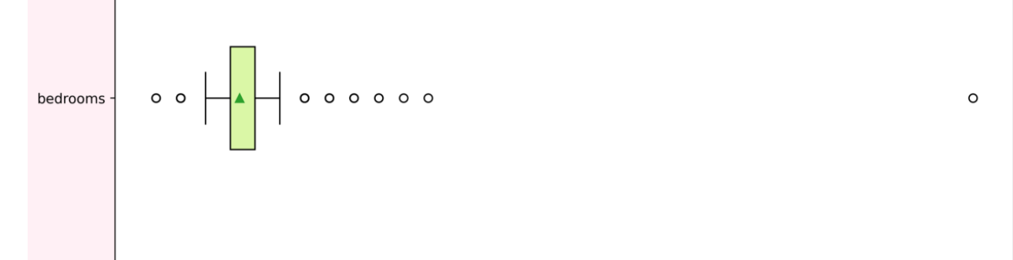
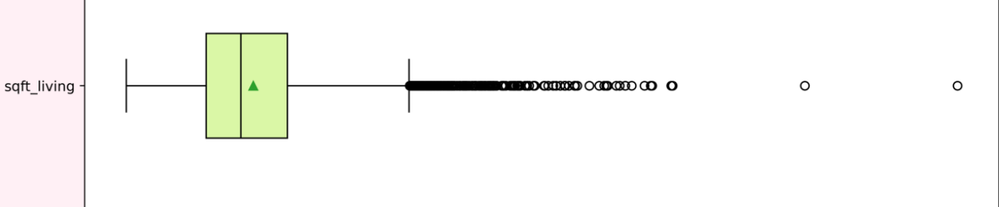
Univariate Analysis
As we can observe from the univariate analysis of bedrooms and sft_living in the graph below there are quite a few values which above the range of upper threshold and even below the range lower threshold which are nothing but the outliers .

Slide 6
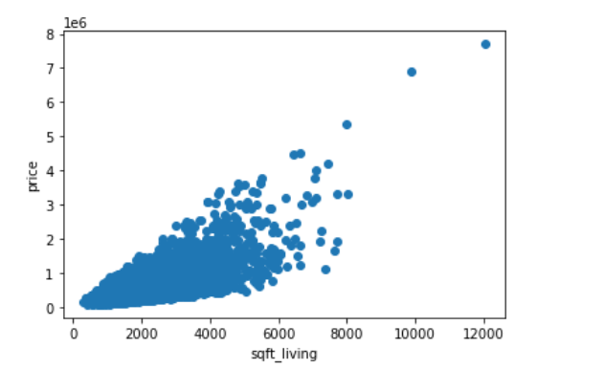
Bivariate Analysis
As we can observe from the below scatter plot as the sqft_living increases price also increases linearly.
The year the house was built has almost no relation to its price

Slide 7
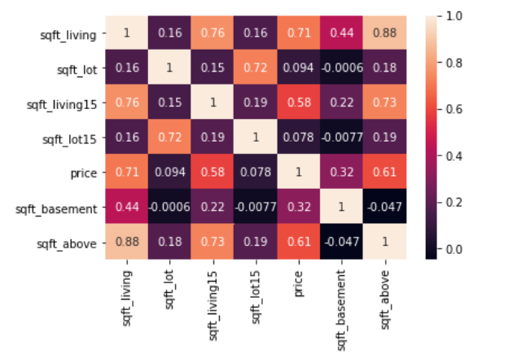
The heatmap represents the correlation between the price and others elements using which we can change the skewness for the attributes.

Slide 8
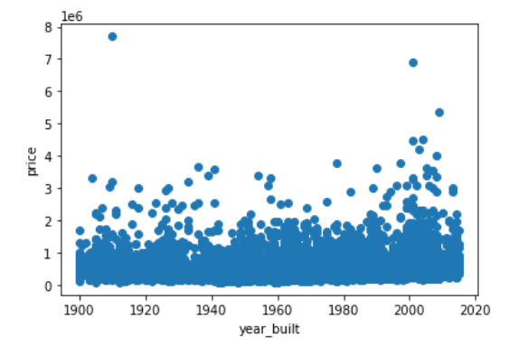
Suprising results
From the scatter plot below we can observe that the year the house was built has almost no relation to its price.

Slide 9
Initial Model Fitting
Model 1
Predictors list =[["sqft_living","grade","sqft_above“]]
Reason – the predictors have a high correlation with the target variable price.
Model 2
Predictors list = [["view","waterfront","sqft_basement","sqft_living15"]]
Reason : next list having the highest correlation in ascending order.
Model 3
Predictors list = [["sqft_living","sqft_lot15","grade","lat","bathrooms","long"]]
Reason : a combination of the best values

Slide 10
Comparing Results
Model 1
RMSE - 256664.407473297
R2 - 0.5350072220902847
Model 2
RMSE - 282841.33104509866
R2 - 0.43556167597779927
Model 3
RMSE - 236514.15003446126
R2 - 0.6058832440681394

Slide 11
Feature Engineering
Log Transformation:
It is a data transformation method in which it replaces each variable x with a log(x).
When our original continuous data do not follow the bell curve, we can log transform this data to make it as “normal” as possible so that the statistical analysis results from this data become more valid.
It improves linearity between our dependent and independent variables.

Slide 12
Square Root transformation
It can be useful for:
Normalizing a skewed distribution
Transforming a non-linear relationship between 2 variables into a
linear one.
Focusing on visualizing certain parts of your data
When you apply a square root transformation to a variable, high
values get compressed and low values become more spread out.

Slide 13
Transforming an existing feature to a new feature
Convert column date to age:
houses["age"]= houses['year']-houses['yr_built']
New column age is created by subtracting year(generated by splitting date column) by year_built.

Slide 14
Result of models for new feature
Model 1:
RMSE 238316.2872438939
R2 0.5991381428832557
Model 2:
RMSE 282038.09891034785
R2 0.4371462396889948
Model 3:
RMSE 226026.1058566554
R2 0.6401366434310699

Slide 15
One-Hot encoding
For a categorical feature having many categories or levels, one-hot encoding is not a great choice from a machine learning perspective, most apparently due to a large number of dimensionality it adds up to. For example, pin code has a large number of levels or categories. Creating a one-hot encoding of zip-code column will add up to massive dimensions with all the values as zero except just 1 column. This numerical vector will not contain much information, just an ocean of 0's.
An increase in the dimensionality of the dataset causes curses of dimensionality, which leads to the problem of parallelism and multi collinearity.

Slide 16

Forward Selection Mechanism
fs = sfs(LR, k_features=8, forward=True, verbose=2,scoring='neg_mean_squared_error',cv=10)
RMSE : 45031917251.46213
r2 score : 0.6846460109606568

Slide 17
Decision Tree
Model 1:
RMSE 251655.27961763568
R2 0.5502802617167384
Model 2:
RMSE 289185.96255501476
R2 0.4128049608344907
Model 3:
RMSE 224772.52648529876
R2 0.6414994622469785

Slide 18
Square Root transformation with Decision Tree
Model 1:
RMSE 250593.9225601086
R2 0.554123265231866
Model 2:
RMSE 225533.76673347587
R2 0.6390512318573426

Slide 19
Transforming an existing feature to a new feature with Decision Tree
Model 1 :
RMSE 241596.88917635102
R2 0.6095968507289543
Model 2 :
RMSE 285343.1873959967
R2 0.4257010345039742
Model 3 :
RMSE 224227.89860029012
R2 0.6431361591158263

Slide 20
Testing the model
When compared the decision tree model and decision tree with new feature model yielded almost the same result for RMSE and R2 .
So we ran the test data using both the models and found that the decision tree model yielded the highest R2 and least RMSE for the predictors of model 3.
RMSE 208432.13720424936
R2 0.6503966661021955

Slide 21
Thank You

